Slide 1

QuickPC -
Prototype
Anthony Dawson
Gustavo Cisneros
Osman Khan
Jose Vasquez
Kevin Vu
Team: PC Gang
CECS 491A Spring 2020

Slide 2
Outline
Purpose
Developer Guide
Project Setup Process
Welcome Page
Login Page
Registration Page
Firebase Authentication
Home Page
Search Page
PC Information Page

Slide 3
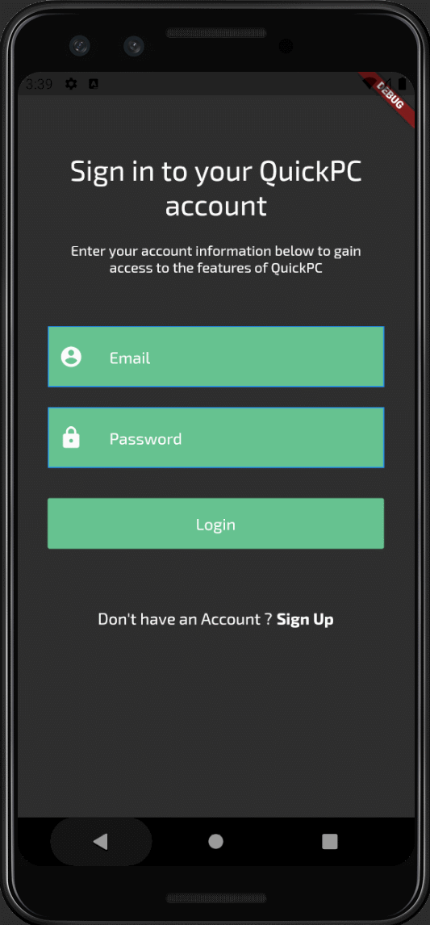
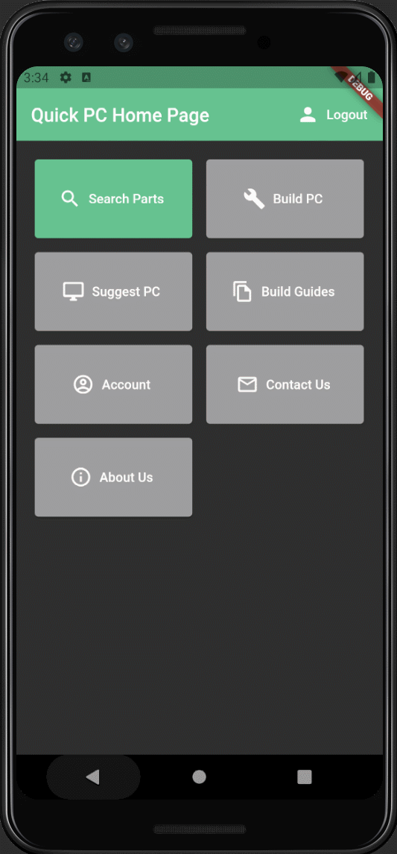
Purpose
Quick PC is a mobile application written in Dart using Flutter. The application is designed to help users compare prices and compatibility of PC components. In this presentation, we explained what each page does such as login, user registration, home, search, and view pc information.

Slide 4



Developer Guide
During our development we used:
Android Studio
Flutter/Dart
Firebase
Git/Github
Features
Welcome
Login
Registration
Home Page
Search Page
PC Information Page
Initial released is planned to be on:
Google Play Store
Apple Store
If you encounter any errors or want to submit a feedback, please contact one of the developers below:
Gustavo Cisneros: gustavo.cisneros@student.csulb.edu
Anthony Dawson: anthony.dawson@student.csulb.edu
Osman Khan: osman.khan@student.csulb.edu
Jose Vasquez: jose.vasquez01@student.csulb.edu
Kevin Vu: kevin.vu01@student.csulb.edu

Slide 5
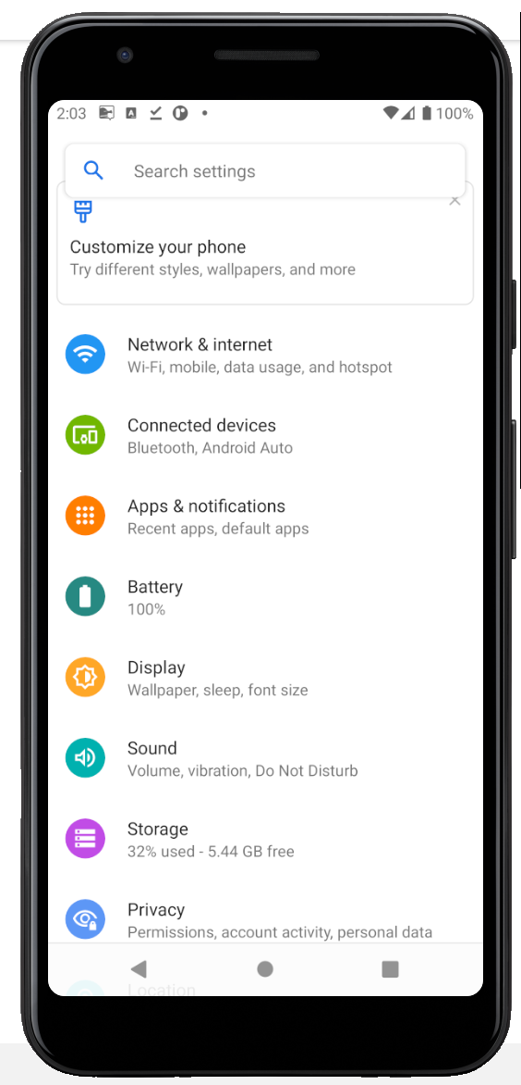
Project Setup Process
Install Android Studio
Serves as the main Integrated development environment (IDE)
Provides a flexible build system that allows the incorporation of 3rd party plugins and SDKs
Android SDK provides a Virtual android emulator Pixel 3a Emulator
Install the Flutter and Dart SDKs
Flutter is a a cross-platform tool that provides the framework to create the apps user interface.
Dart is the language used to code Flutter applications.
Setup Firebase
Provides a plugin that allows us to create and connect to a cloud database
Install and Setup Git/Github
Git is a local tracking system that is used to maintain data integrity
Github allows us to store a copy of our local Git repository online

Slide 6
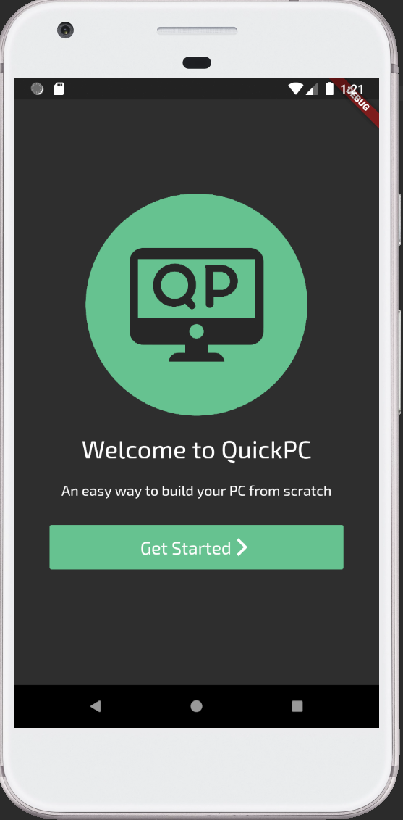
Welcome Page
When the user first opens the application, they are prompted with a welcome page.
Our welcome page consists of our logo and motto.
The user is able to access the login and registration phase of the application after they click “Get Started”.

Slide 7
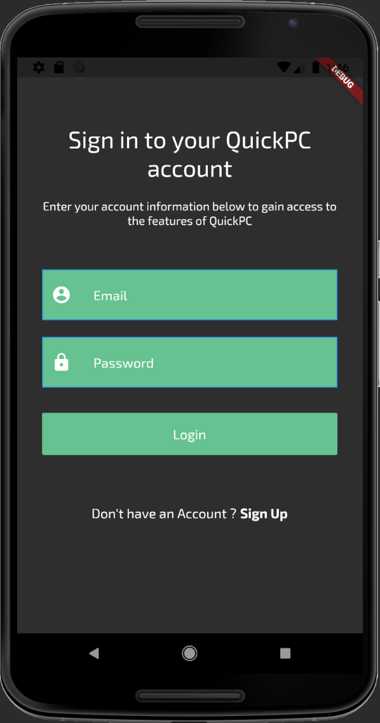
Login Page
If a user already has an existing account they can log in using their email and password.
Login Steps
Step 1: Enter valid email, cannot be empty
Step 2: Enter valid password
Step 3: Click “Login” button
Our program checks if the account exists in our Firebase database and if it does not exist an error is displayed.
If a user does not have an account in the database, they can create an account by clicking on the “Sign Up” button which directs them to the registration page.
If a user successfully signs in they will be directed to the home page.

Slide 8
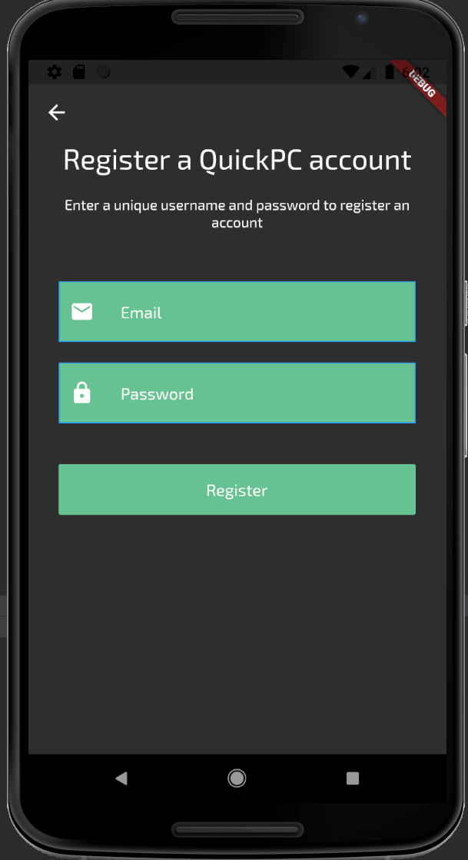
Registration Page
If a user does not have an existing account, they can create one by accessing our registration page.
To register successfully follow the steps below:
Step 1: Enter a unique email that is valid
Step 2: Enter a password that is at least 6 characters
Step 3: Click “Register”
Once the user types in a unique email and password, their account will be added to the Firebase database.
The user will now be directed to the home page and access the features of QuickPC.

Slide 9
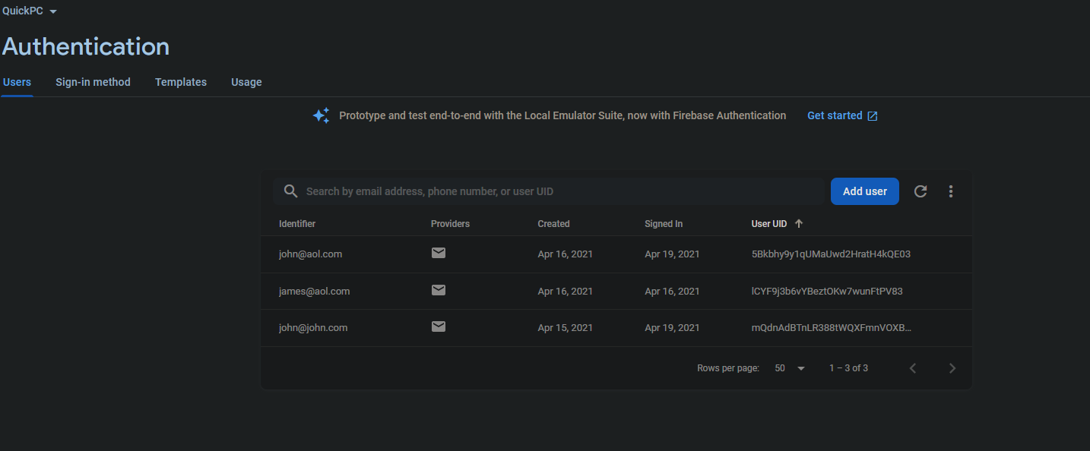
Firebase Authentication

Slide 10
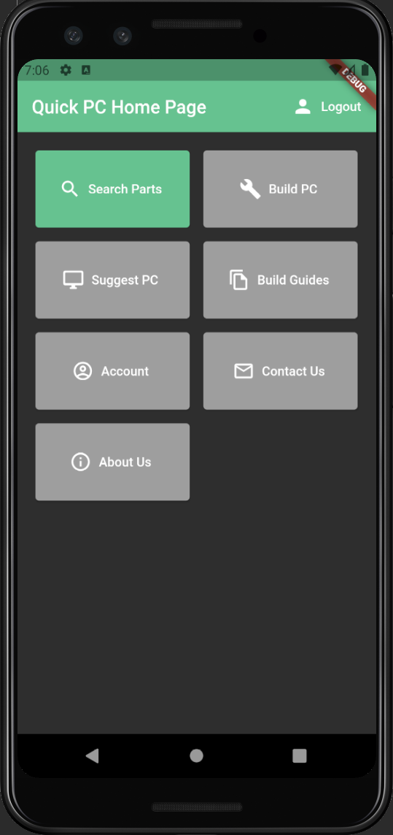
Home Page
On the home page the user is presented with some of the functions we wish to implement into Quick PC.
From here we’ll show off the Search function.
Search for parts Find PC suggestions Manage user account Learn about us | Build a PC View build guides Contact Us

Slide 11
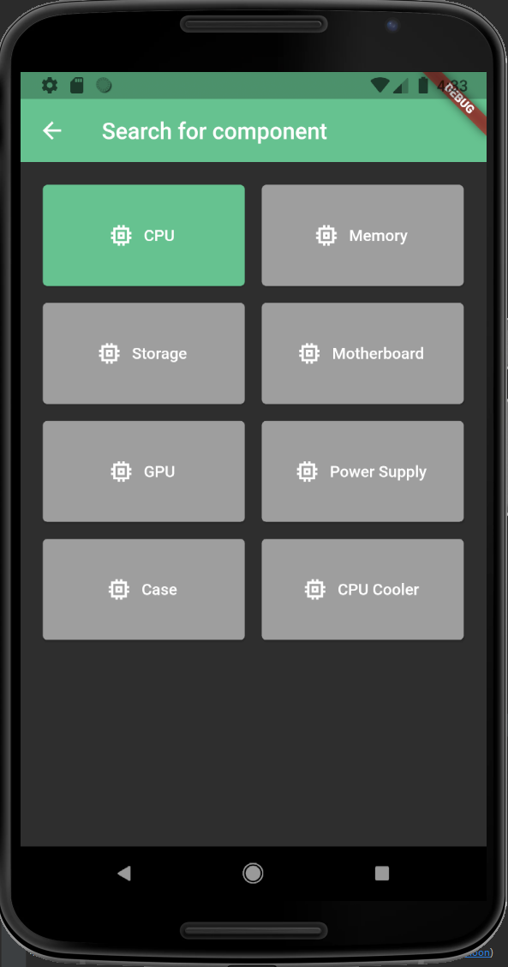
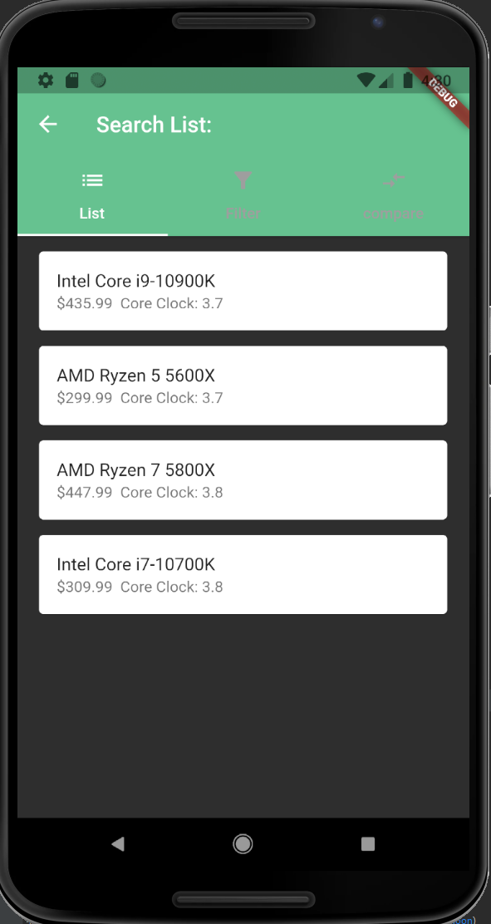
Search Page
After selecting Search the user must select what type of part they want to search for.
After selecting a type of part the app pulls a list of parts from the FireBase database.
In the “Filter” tab the user can select filters to sort and filter the list.
In the “compare” tab the user can see a quick comparison between selected parts.
The user can select a specific part and learn more about on the info page.

Slide 12
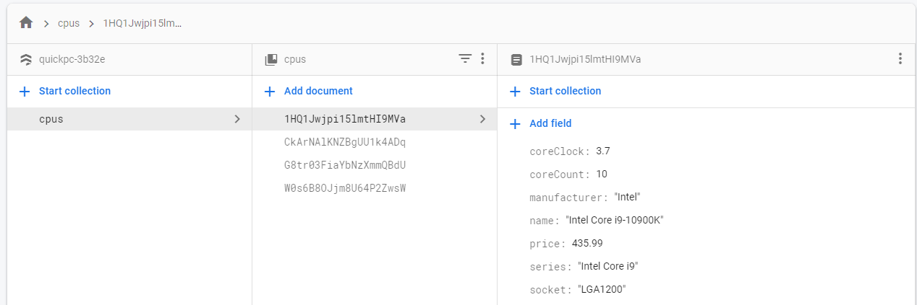
Firebase Database

Slide 13
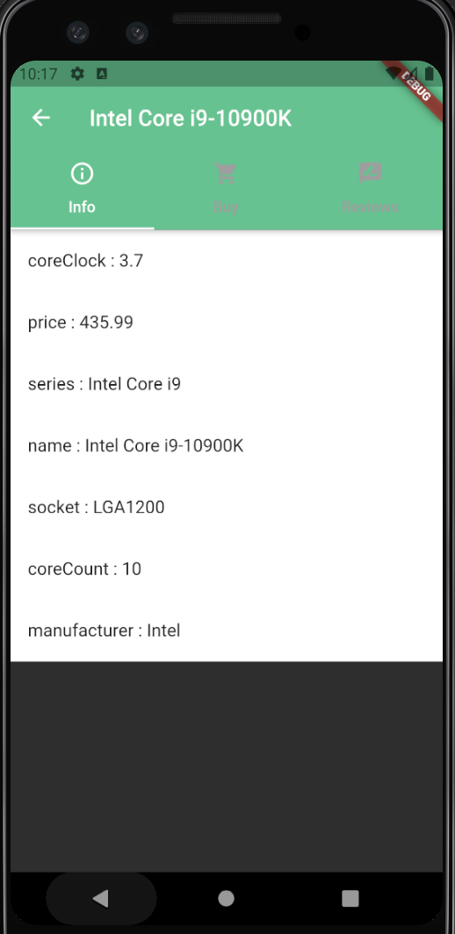
PC Information Page
The PC information page displays critical information for specific components
Information pages differ for different kind of components
CPU pages will show core counts, clock speeds
Power supply pages will show wattage, rating, etc.
Information for parts are shown on an information tab within the page, links to retailers are in the “Buy” tab
Reviews can be seen in the “Reviews” tab, where users can read reviews or write a review

Slide 14
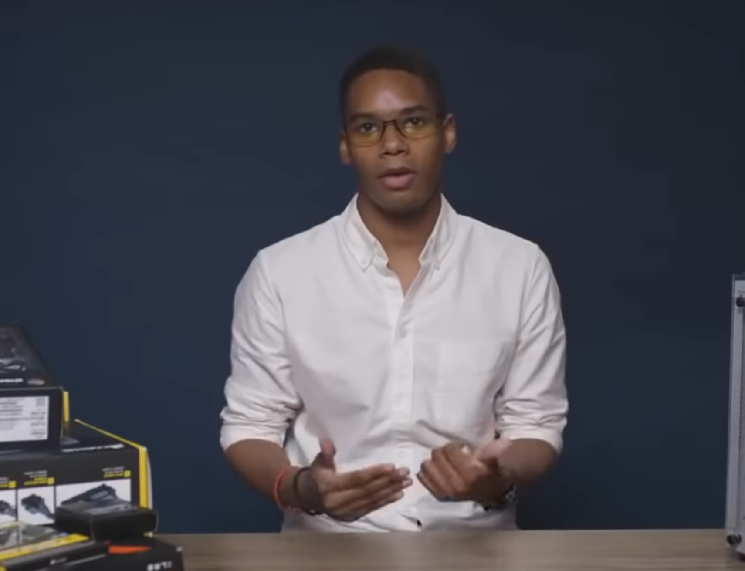
Any questions?

